Slide 1



Docker Kubernetes Support
What does it mean for you?
controlplane

Slide 2
The Big Announcement
In October 2017, Docker broke the big news that they'll be adding Kubernetes support to Docker:
https://blog.docker.com/2017/10/kubernetes-docker-platform-and-moby-project/
It will work by putting Kubernetes and Swarm on equal footing as orchestrator choices for Docker
controlplane

Slide 3
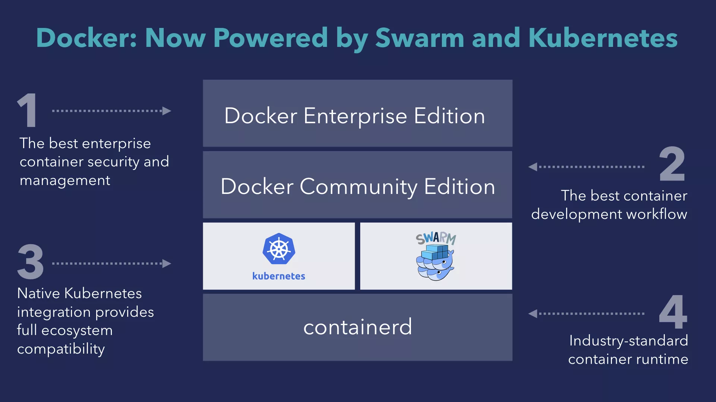
(Source: https://www.docker.com/kubernetes)
controlplane

Slide 4
The Big Announcement
What progress has been made since the announcement?
When can we expect it to be ready?
How does it work?
This is what I'll be talking about today!
Disclaimer: I don't work for Docker and don't know their strategy or roadmap beyond what has been publicly stated
controlplane

Slide 5
The Announcements in More Detail
From Solomon’s announcement blog post:
“...check out the detailed blog posts to learn how we’re bringing Kubernetes to:
Docker Enterprise Edition
Docker Community Edition on the desktop with Docker for Mac and Windows
The Moby Project”
And from https://www.docker.com/kubernetes:
“We’re adding Kubernetes support in both Docker Community Edition on the desktop for developers using Windows and macOS, and in Docker Enterprise Edition. The bulk of the Kubernetes integration work happens in the open in the Moby Project.
controlplane

Slide 6
The Announcements in More Detail
Note that desktop Docker CE is the only Docker CE getting a mention; they're very specific about where it's supported in Docker CE
Clearly Docker are focusing their investment on a workflow from desktop to Docker EE in production, therefore Docker CE Linux server use-case is seemingly not on the roadmap
controlplane

Slide 7
What is Available to us Today?
The announcement said that most of the integration work happens in Moby
In part, that’s referring to LinuxKit, a tool for building minimal Linux OS images, described in YAML
It underpins Docker for Mac and Docker for Windows
Today, you can use the Docker for Mac or Docker for Windows installers to get Kubernetes on a desktop that you can deploy to with Docker
controlplane

Slide 8
What is Available to us Today?
This requires Docker for Mac 17.12 CE Edge and higher or Docker for Windows 18.02 CE Edge. Docker EE Kubernetes support requires access to the beta programme
Here are the links to the announcements:
Mac, 09/01/2018: https://blog.docker.com/2018/01/docker-mac-kubernetes/
Win, 30/01/2018: https://blog.docker.com/2018/01/docker-windows-desktop-now-kubernetes/
Docker EE, 18/01/2018: https://blog.docker.com/2018/01/docker-ee-kubernetes/
To play with Kubernetes on Docker, try Docker for Mac & Windows desktop
controlplane

Slide 9
I’m a Developer; what can I do with it?
The following example is taken from the Docker Blog, here:
https://blog.docker.com/2018/02/docker-compose-kubernetes-docker-desktop/
Deploy a compose stack to Kubernetes:
$ docker stack deploy --compose-file words.yaml words Stack words was created Waiting for the stack to be stable and running... - Service db has one container running - Service words has one container running - Service web has one container running Stack words is stable and running
controlplane

Slide 10
I’m a Developer; what can I do with it?
This has created Kubernetes resources under the hood:
$ kubectl get deployment NAME DESIRED CURRENT UP-TO-DATE AVAILABLE AGE db 1 1 1 1 2m web 1 1 1 1 2m words 5 5 5 5 2m $ kubectl get pods NAME READY STATUS RESTARTS AGE db-5489494997-2krr2 1/1 Running 0 2m web-dd5755876-dhnkh 1/1 Running 0 2m words-86645d96b7-8whpw 1/1 Running 0 2m words-86645d96b7-dqwxp 1/1 Running 0 2m words-86645d96b7-nxgbb 1/1 Running 0 2m words-86645d96b7-p5qxh 1/1 Running 0 2m words-86645d96b7-vs8x5 1/1 Running 0 2m $ kubectl get services NAME TYPE CLUSTER-IP EXTERNAL-IP PORT(S) AGE db ClusterIP None 55555/TCP 2m web ClusterIP None 55555/TCP 2m web-published LoadBalancer 10.104.198.84 80:32315/TCP 2m words ClusterIP None 55555/TCP 2m
controlplane

Slide 11
I’m a Developer; what can I do with it?
We can see here some artefacts of Docker’s translation from a Compose stack into Kubernetes services
The single web Docker service with an exposed port becomes two Kubernetes services- web and web-exposed; the latter of which is a load balancer
You can watch a video of Elton Stoneman explaining all of this here:
https://www.youtube.com/watch?time_continue=2&v=h4J8xQWlsQw
controlplane

Slide 12
What about Docker Enterprise Edition?
As you have seen, it’s clear that at least the basic Docker Kubernetes integrations are in place, even if a little bleeding-edge
What about Docker EE?
As you no doubt know, Docker EE consists of Docker Datacenter (Enterprise Docker distribution) and Universal Control Plane (its UI dashboard)
There is a video showing UCP with Kubernetes support here:
https://youtu.be/h2B6mhDCw2o
I have some screenshots from it 😱😹
controlplane

Slide 13
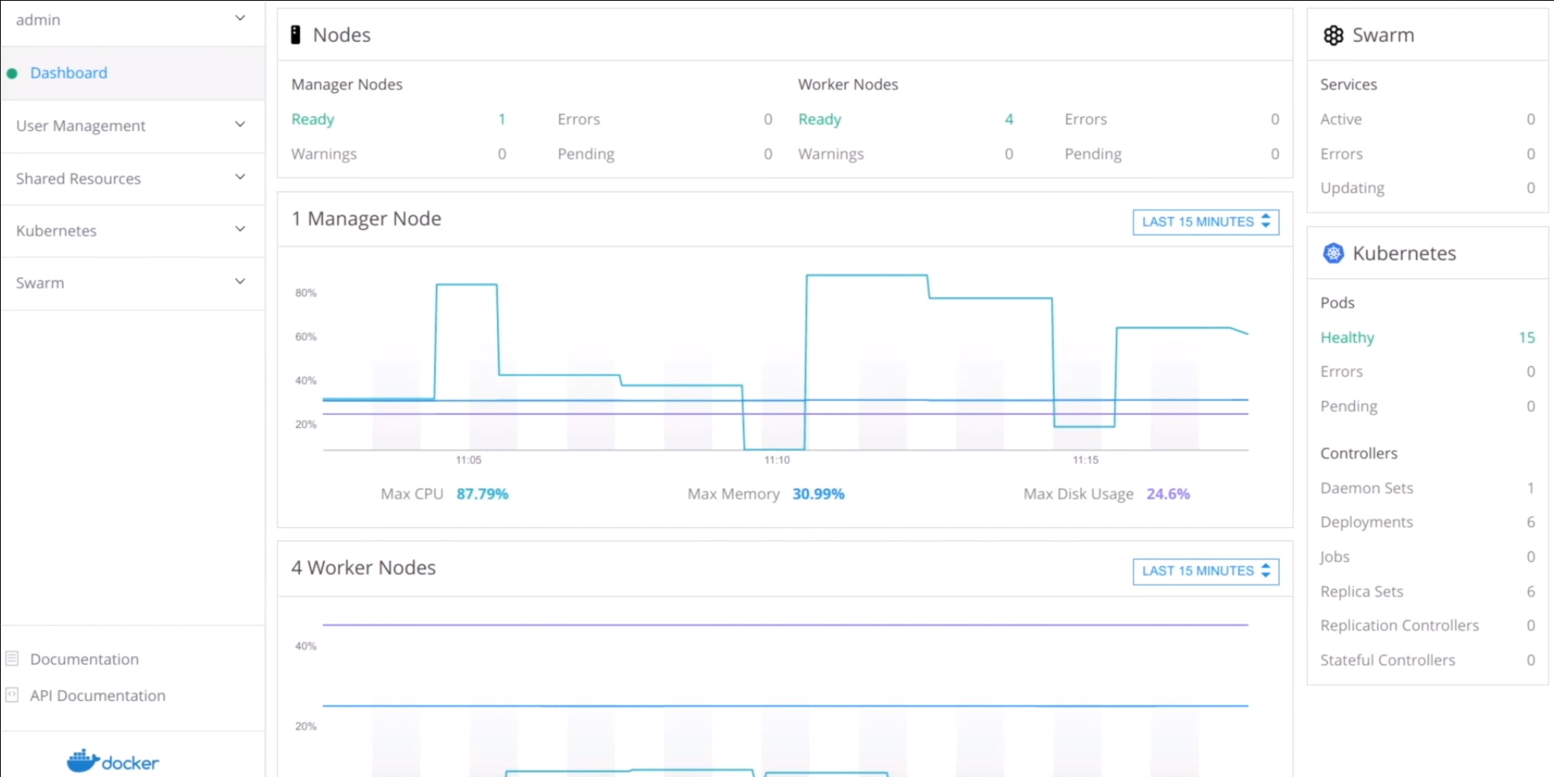
What about Docker Enterprise Edition?
controlplane

Slide 14
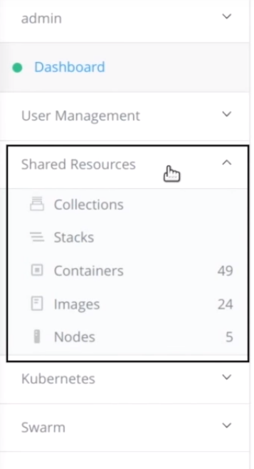
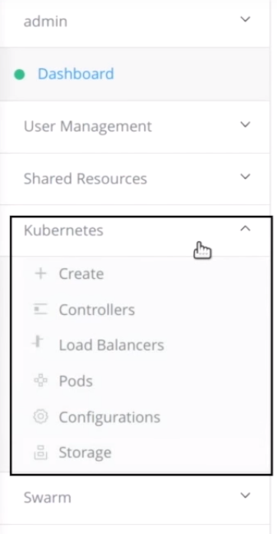
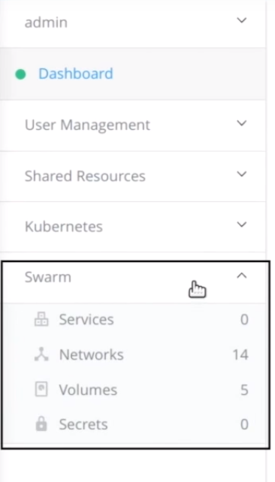
What about Docker Enterprise Edition?
controlplane

Slide 15
What about Docker Enterprise Edition?
Docker have some new features that arrive with the Kubernetes integration:
Kubernetes integration to Docker EE access controls
One of the biggest features Enterprise needs is good RBAC; Docker EE has this, and they’ve extended it to Kubernetes
Kubernetes integration to Docker Trusted Registry
Controls around the Docker EE registry for signing and image promotions apply across orchestrators
controlplane

Slide 16
So what does this mean for you?
If you're a Docker shop, you won't be left behind by Kubernetes taking over
If you found Swarm to be limiting, you now have the full power of Kubernetes
It looks like you have the best of both worlds
It doesn't appear to be a hamstrung Kubernetes
I presume you'll be able to use Kubernetes-native tooling
Docker EE's features are compelling; you keep those, of course, and they apply to Kubernetes now too (e.g. RBAC, Trusted Registry)
If you're rolling-your-own Kubernetes and are looking for an Enterprise distribution, Docker EE is now an option for you
controlplane

Slide 17
Thank you!
I’ll send out a link to these slides on Twitter:
https://twitter.com/lukeb0nd
ControlPlane are a London-based security and continuous-delivery focused Kubernetes consultancy
https://twitter.com/controlplanio
controlplane

